Slide 1
DSI Project 1 building pokemon stay
By Alex Yi Zhou

Slide 2



OUR MISSION:
No more Accidents!
More Certainties!

Slide 3
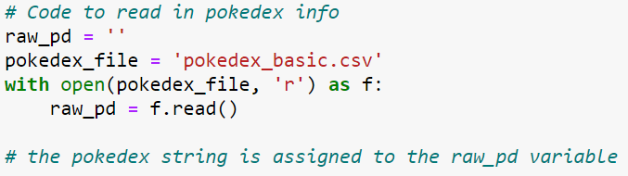
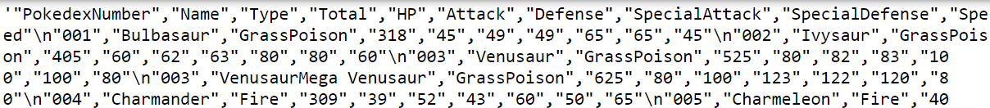
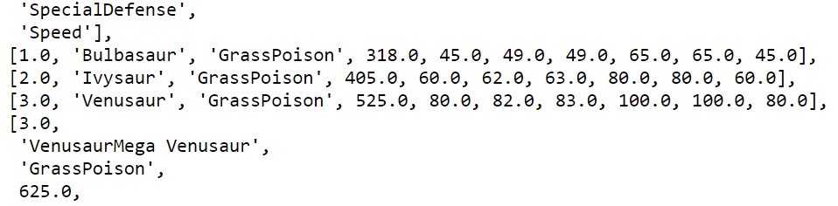
lolu: “List of lists updated”

Slide 4
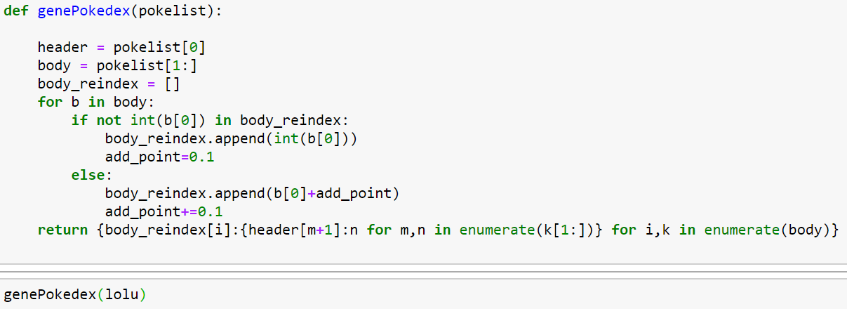

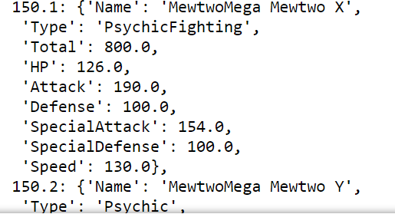

Pokemon index mean a lot to players!!
#249
#151

Slide 5
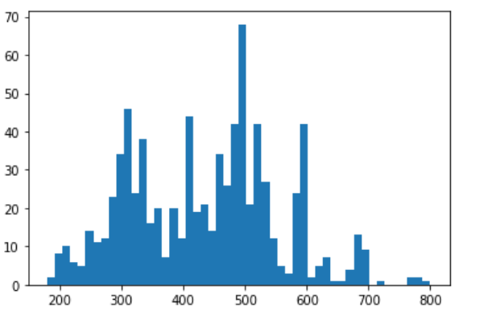


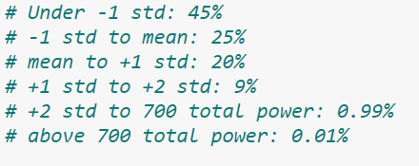
Pokemon Distribution on Total Power

Slide 6









ETC.

Slide 7
Thank you for listening

